Slide 1
The Road Towards Transformative Agreements in Sweden
Wilhelm Widmark
Stockholm University Library
wilhelm.widmark@su.se
@WilhWid | @SthlmUniPress | @SthlmUniLib
Presentation at LundOnline 31th October 2019
Notes:
This work is © The author and Stockholm University. Shared with a Creative Commons license CC-BY 4.0 https://creativecommons.org/licenses/by/4.0/
Emoticons used throughout the presentation are from Twemoji, via a CC BY 4.0 license. More info: https://github.com/twitter/twemoji

Slide 2
Open Science as a practise
“Stockholm University advocates the availability of its research and research results through a research and education environment that promotes, encourages and informs about open science as a practice”
Forskningsdatapolicy Stockholms universitet Dnr SU FV 5.1.1-1780-17, 2018-02-22

Slide 3
Transition to Open Access in Sweden
“The goal is that a transition to open access to research results, including scientific publications, artistic works and research data, should be fully implemented in a ten-year perspective.” (The Swedish Research Bill, Knowledge in Collaboration 2016/17:50)
Notes:
The national goal in Sweden is that all scientific publications resulting from research financed with public funds should be published immediately open access and that research data, on which the scholarly publication is based, should be made open access together with the publication. The ambition is that transition to open access to scholarly publications, research data and artistic works should be fully implemented in 2026 at the latest.
The Swedish Government states that clear incentives and mechanisms are needed in order to encourage researchers to publish their research output immediately open access and that it is a shared. All stakeholders within the research system have a responsibility to work towards this goal. Open Access work within the process of publications have been going on for many years in Sweden, but quite slowly. The work with Open Access to research data has just recently been speeding up.

Slide 4
Influences Open Science
Funders
Researchers
Politics
Society
Ethics and law
Research infrastructures
Research Organisations
Publishers

Slide 5
Government Directive for Open Access
The National Library of Sweden – National coordinating body in Open Access to sholarly publications - Open Access Advisory Group - National working groups OA
Swedish Research Council – National coordinating body in Open Access to Research Data - National Reference Group
Image Credit Creative Commons CCO 1.0
Notes:
The National Library of Sweden has worked with advancing open access to scholarly output, so that research results should be freely available online for everyone to access without cost, and that the material is free to reuse since 2006 .
At the beginning of 2017 the National Library of Sweden received an appropriation directive from the Swedish Government to act as a national coordinating body in the work towards a transition to open access to scholarly publications.
An open access advisory group with representatives from the main stakeholders has been established - representation from the Association of Swedish Higher Education (SUHF), the Swedish Research Council (VR), the Swedish Society for Humanities and Social Sciences (RJ), Young Academy of Sweden (SUA) and the Association of Swedish Special Libraries. Its role is to support the National Library as coordinating body for open access. The current chair is Astrid Söderbergh Widding, Vice-chancellor of Stockholm University.
In the Swedish Research Council's report "Proposal to National Guidelines for Open Access to Scientific Information", a number of obstacles to a transition to an open access publishing system were identified. On the basis of this report the National Library of Sweden initiates and coordinates the studies concerning:
The current merit and resource allocation system versus incentives for open access
Funding for a transition from a subscription-based to an open access publishing system
Open access to scholarly monographs
Financial and technical support for converting peer-reviewed and scholarly journals from toll access to open access
Monitoring of compliance with open access policies and mandates
Five national working groups have been formed on the above topics, with stakeholder representation from Swedish funding agencies, HEIs and researchers.
Swedish Research Council is the national coordinating body in Open Access to Research Data since 2017
Swedish Research Council's report "Proposal to National Guidelines for Open Access to Scientific Information“ (2015)
Two parallel assignments for OA to publicly funded scientific publications and research data - compliant to FAIR principles (2017)
The National Library of Sweden (NLS) together with The Swedish Research Council
Report to Ministry of Education in February, 2019
Two processes that are in different phases of development and with need of different skill. Two authorities with different history, culture and workflows.
Two new assignments from the Swedish government in 2018 regarding open access to publicly funded scientific publications
NLS is instructed to monitor and report the total cost of publication for scientific publications in Sweden with a particular attention to costs regarding subscriptions, publication charges (APCs), and administrative expenses.
NLS shall also develop indicators for assessing whether scientific publications meet the national objective that scientific publications which are the result of public funding, should be fully open access by 2026 and propose a method that provides a comprehensive overview of the extent to which scientific publications and research data meet the FAIR principles. There are different national working groups working with this.
The Swedish Research Council has received a parallel assignment from the Government, instructing the council to develop criteria assessing the extent to which research data, partly or fully resulting from public funding, complies with the so-called FAIR principles.
The NLS will consult with the Swedish Research Council regarding this part of the assignment, which shall be reported to the Ministry of Education February, 2019.
https://www.vr.se/omvetenskapsradet/regeringsuppdrag/avrapporterade2015/avrapporterade2015/nationellariktlinjerforoppentillgangtillvetenskapliginformation.4.7e727b6e141e9ed702b1307e.html

Slide 6
Studies
The current merit and resource allocation system versus incentives for open access
Funding for a transition from a subscription-based to an open access publishing system
Open access to scholarly monographs
Financial and technical support for converting peer-reviewed and scholarly journals from toll access to open access
Monitoring of compliance with open access policies and mandates

Slide 7
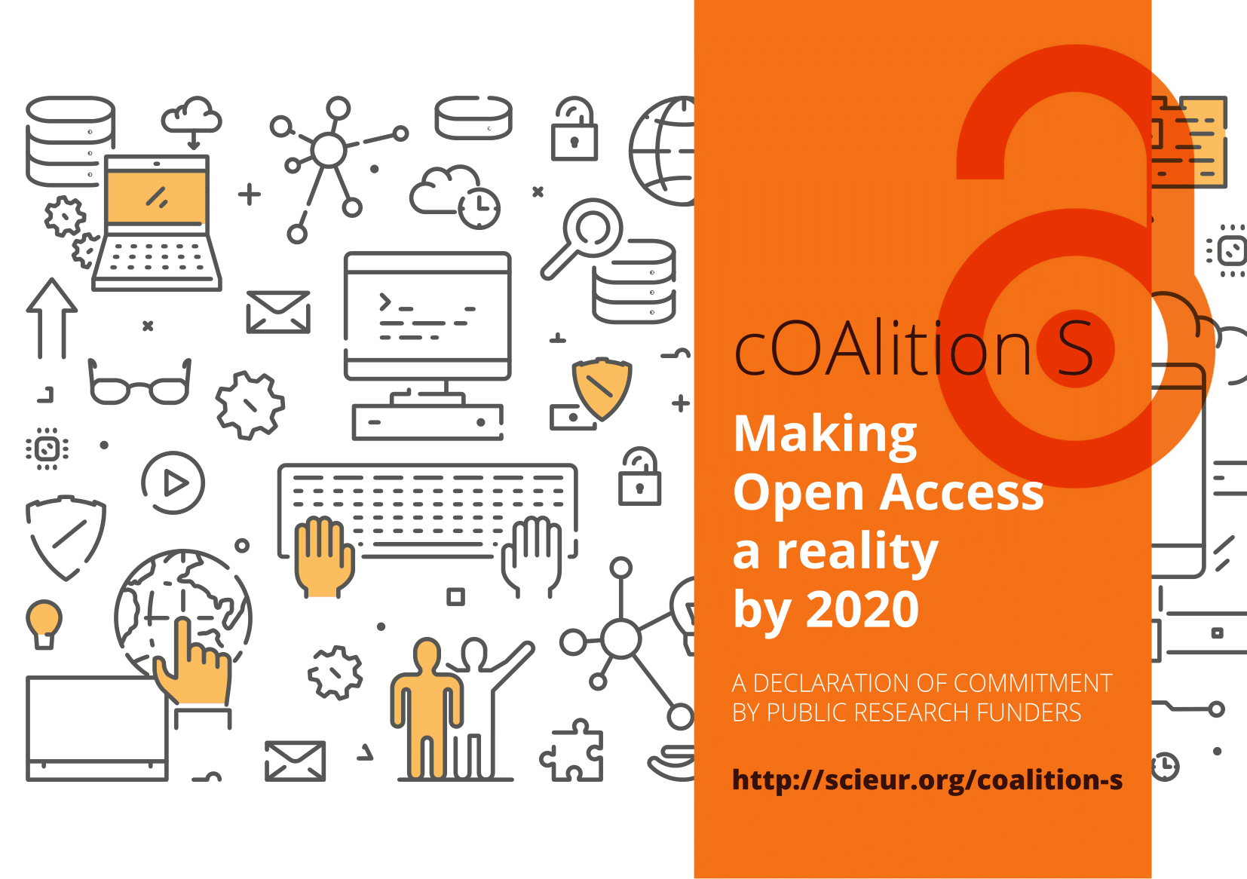

Slide 8
What is Plan S?
Research funders’ action plan to make their funded output available
An initiative aiming to push publishers to change
To address rapidly increasing publishing costs
Encouraging technical developments & best practice
Notes:
It’s a “work in progress”
Focus on Journal articles
Connected to students’ use of research material - should be able to continue after graduation
Stakeholders coming together – but not enough. More of this in the future.

Slide 9
Goals for Plan S
Creative commons-licensing on the ‘open side’
Update electronic platforms and formats to allow TDM
No embargo times & transformative agreements
Start 2021, evaluation of results 2024
Notes:
Also include putting copies in repositories with proper licensing, works with both version of record or author’s version
How do we get there?
The research community - with decisions on where to publish & editorial activity
Universities - read & publish agreements
Research funders - support & require OA publishing

Slide 10
Implications of Plan S
Publishers need to update policies and business models
Smaller publishers & repositories need to upgrade
Funding to cover publication fees only for pure OA content
Researchers will have to make better informed decisions
Libraries to manage better deals & cash flows
Notes:
Stakeholders have different roles in the changing landscape
Publishers will have to do the most work
Society publishers may have a hard time
Smaller non-profit journals may struggle with the technological shift (but they would to that anyway)
Systems for measuring merit need to be discussed

Slide 11
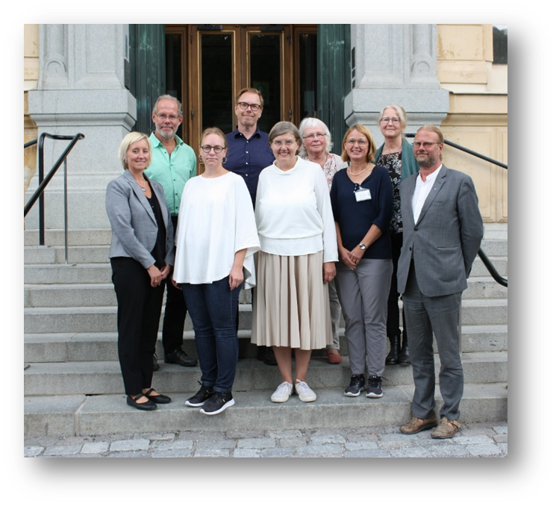
Bibsam Consortium
Formed in 1996
85 participating organisations: HEIs, government agencies & research institutes
50 agreements, 300 e-resource packages
Turnover approx. € 30,7 million (2018)
Bibsam consortium steering committee
Chair: Vice Chancellor of Stockholm University Astrid Söderbergh Widding
6 representatives from HEIs + 1 representative from the special libraries (non academic)
2 representatives working for the Bibsam Consortium at the National Library of Sweden
Notes:
To support the HEIs
We negotiate 50 agreements comprising of approx. 300 e-resource packages

Slide 12
Negotiating transformative deals
Deals
Preconditions
New market
Different business models
Pilots
Negotiations takes long time
Shorter agreements
Springer Compact
Springer Nature Fully OA
IOP
De Gruyter
Royal Society of Chemistry
Taylor & Francis
Cambridge University Press
Oxford University Press
AIP

Slide 13
Springer Nature Fully OA
Imprint | Tidskrift | Antal tidskrifter 2019 | Publicerings-avgifter
 | BMC series | 70 | €990 - €1999
 | BMC academic journals | 242 | €700 - €2990
 | BMC Flagships | 4 | €2270 - €3060
 | SpringerOpen journals | 195 | €510 - €2170
 |  | 1 | €4290
 |  | 3 | €2570
 |  | 1 | €1490
 |  | 1 | €1390
 |  | 23 | €1310-€2790
 | Academic OA journals | 18 | €1430 - €3580
 |  | 1 | €990
 | Total | 559

Slide 14
Deals Under Negotiations 2019
Wiley
Elsevier
SAGE
American Chemical Society

Slide 15
Swedish Rectors’ Conference
The Association of Swedish Higher Education Institutions (SUHF)
Established 1995, 37 members
“An arena for cooperation”
Library Directors Forum (2006)
Open Science Group (2017)
SUHF chairs the Bibsam Steering Committee
SUHF chairs the Open Access Advisory Group

Slide 16
Swedish Rectors’ Conference
2016:
Open Science is not a library question!
But the libraries could help in building infrastructures, lobbying and education
Open Access should be a question for the management of the universities
2018:
The Rectors´ Conference advised Bibsam to cancel the agreement with Elsevier

Slide 17
Cancellation with Elsevier

Slide 18
Feedback Form
Set up in July to inform researchers about the cancellation and allow them to send feedback
Only received an overview from Elsevier once…

Slide 19
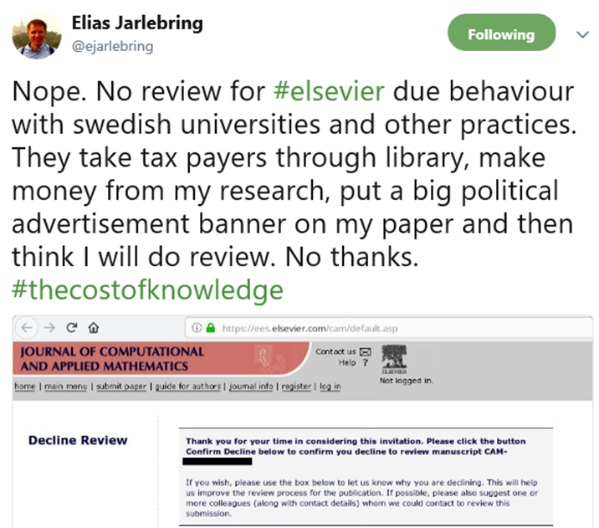
Positive Response from Researchers
There are plenty of academic organisations publishing journals of higher quality than Elsevier. We don't need Elsevier!
I just want to express my support for the decision to not accept Elsevier's subscription terms.
Thank you Bibsam for taking this stance.
I would like to state that, even though this may create some problems for my own research work, I fully support Bibsam's cancellation of the agreement with Elsevier.
I hope Bibsam will continue to stand up for open, transparent and affordable publication of research articles
Notes:
Of course we have received some critical views as well, but then mostly from a “personal” perspective
Elsevier runs all of the important journals in my field of composite materials. It is absolutely vital for me to have access to these in my work.
We need access for our research, as it is now we cannot even read our own articles!
Not a very good decision. We use these journals daily.
You leave us no choice now but to use other means of access to publications (e.g., sci-hub).
Therefore sent replies to all “We are sorry that the cancellation of the subscription has caused you trouble, but it is our strong belief that this action is necessary to take the negotiations with the publisher to the next level. We also would like to point out that the decision to cancel the subscription is based on an unanimous recommendation by the general assembly of SUHF (the Association of Swedish Higher Education Institutions), that is, the decision was taken in total agreement with all Higher Education Institute vice-chancellors in Sweden.”
Please find more information here:
http://openaccess.blogg.kb.se/2018/06/20/qa-about-the-cancellation-of-the-agreement-with-elsevier-commencing-1-july/#more-4944
Alternative routes to scholarly articles and research outputs:
http://openaccess.blogg.kb.se/2018/07/01/alternative-routes-to-scholarly-articles-and-research-outputs

Slide 20
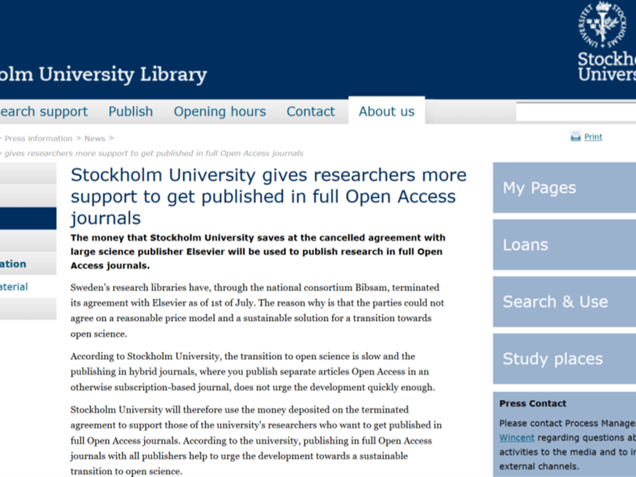
University Initiatives
Stockholm University
Get published in full Open Access free of charge. The money that Stockholm University saves from the cancelled agreement with Elsevier will be used to publish research in full Open Access journals
Notes:
This is why this presentation actually fits into this slot “delivering open access on a large scale to our researchers”

Slide 21
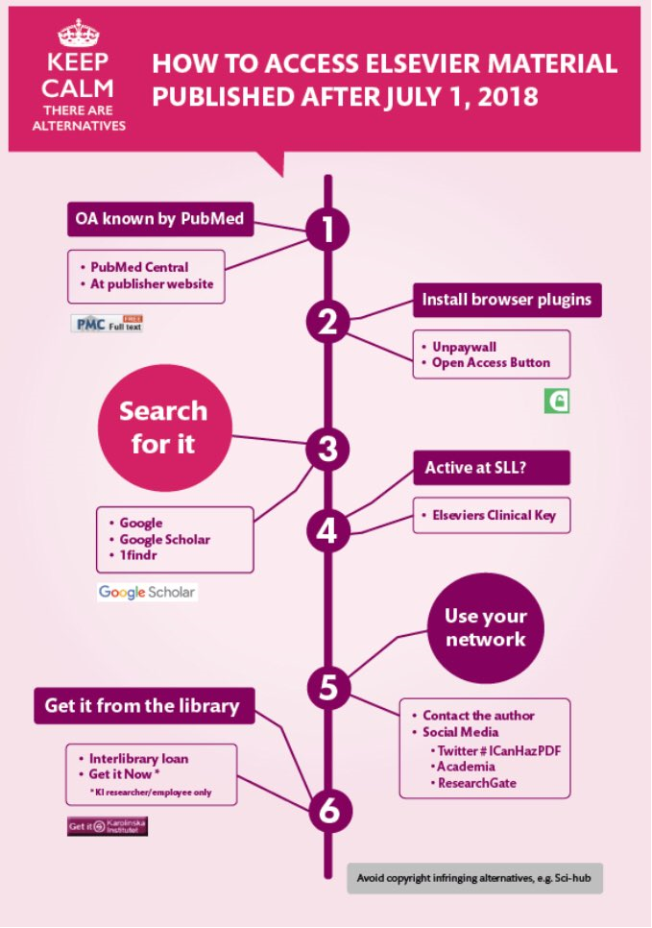
University Initiatives
Karolinska Institute
How to access Elsevier material published after July 1, 2018
OA known by PubMed
Install browser plugins
Use your network
Get it from the library
”Get it know” service available
Peter Sjögårde, Karolinska Institutet

Slide 22
Lessons Learned so far…
Support from the Vice Chancellors is extremely important
Political backing
Preparation is everything
Get in control of your own publication data
A communication plan is needed
Researchers seem to manage fairly well without current access to Elsevier journals
Services like ”Get it now” are not yet as heavily used as expected
Never underestimate your opponent…

Slide 23
National Survey on the Cancellation with Elsevier
4221 respondents
–85 % researchers/research students at HEI
–7 % government agency users
–5 % students
Have you needed access to articles published by Elsevier that your institution didn't have access to since the cancellation?
YES 81 % (1-5 art 29 %; 6-10 art 23 %; 10< art 28 %)
NO 15 %
91% knew of the cancellation

Slide 24
What do users do when they lack access?
– 42 % given up, 42 % found the article online, 23 % used library, 22 % contacted author/colleague
• What do users think?
– 54 % say it affected their work negatively, 37% were not affected
– 48 % are negative to cancellation, 38 % are positive and 13 % do not know.
• Who is negatively affected?
– Users in more research intensive subject areas
• Who opposes cancellation?
– Mainly those that are negatively affected but there is ambivalence.

Slide 25
Strategies to access articles
– No (42 %)
– Online (42 %)
– Library (inter-library loan, get it now, or other library service) (23 %)
– Contacted author (22 %)
– Contacted colleague (22 %)
– Other(10 %)
If you replied "online": Where online did you access the article(s)
–Research Gate (45 %)
–Sci-Hub (24 %)
–Don’t remember (21 %)
–Author web page (15 %)
–Other options…
75 % did not have a plug-in to find OA installed

Slide 26
Negotiation Process 2019
May 2019
First offer from Elsevier
August/september 2019
Negotiations
6 november 2019 Steering Committee take the formal decition
Dec 2018 High level meeting
April 2019 MoU signed
June 2019 Second revised offer
23 october 2019 SUHF Rectors conference will discuss the offer
Notes:
Lägg till Mou Förlänga med vad som kommer nu, förbundsförsamling, styrgrupp mm
-Omförhandlingarna startade våren 2016
-Ettårig förlängning av avtalet vid årsskiftet 2016/17 med 3,75 % prisökning
-Högnivåmöte mellan Elsevier och representanter från regeringen, VR, SUHF och KB under hösten 2017
-På grund av att förhandlingarna inte kunde slutföras vid årsskiftet, förlängdes avtalet tillsvidare (månad för månad) under 2018 med 3,75 % prisökning
-SUHF förbundsförsamling diskuterar vägval 14/3
-6/4 högnivåmöte då Elsevier får besked att modellen som erbjuds inte motsvarar Bibsamkonsortiets krav
-2/5 förlängning av avtalet sägs upp per 30 juni 2018
-16/5 pressmeddelande skickas ut
-18/5 inbokat möte med Elsevier, förhandlingarna återupptas

Slide 27
How can we fund the transition?
Is there enought money in the system?
Meeting between a group of presidents from the universities and the big research funders i Sweden
A discussion on how we can cofund the transition

Slide 28
Prioritisation in Policy Making
One of the key issues is that different policy approaches have implicitly been based on different assumptions on the balance of priorities
All policy decisions arguably involve a balancing of three priorities:
Achieving OA quickly – prioritising ways to make as much content OA as possible without delay system-wide
Reducing costs – achieving cost savings in a system which has experienced cost rises above inflation over long periods of time
Transforming the system – achieving fundamental change in the scholarly communication system, often including challenging (even replacing) existing players and service-delivery models in the market
Achieve OA quickly
Reduce costs
Transform the system
Many policy initiatives are attempting to deliver all three to a greater or lesser extent but with different emphases. They can therefore be placed on a ‘triangle plot’ to indicate the prioritisation underpinning them.

Slide 29
Thank you!
www.stockholmuniversitypress.se
https://su.se/library
Twitter @WilhWid | @SthlmUniPress | @SthlmUniLib
Notes:
What are your thoughts about our role as a university press. What do you think we should do? What do you think the researchers need? Why do they need it?

