Slide 1
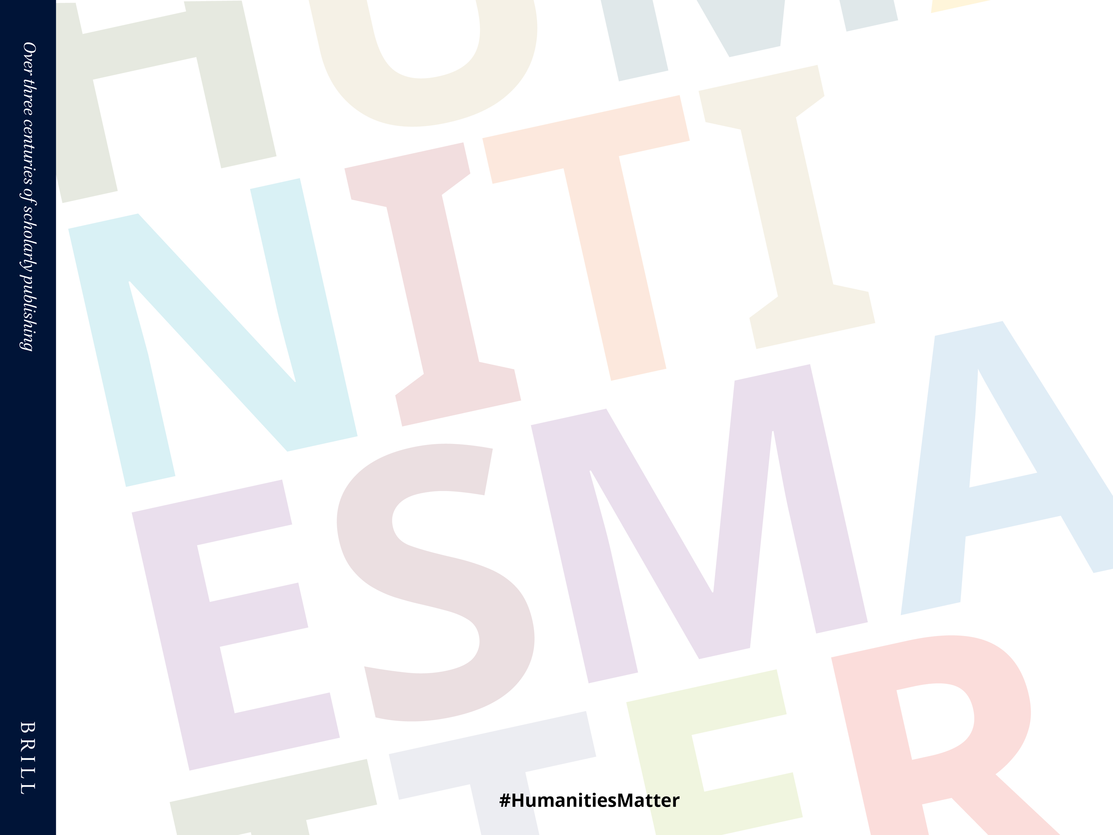
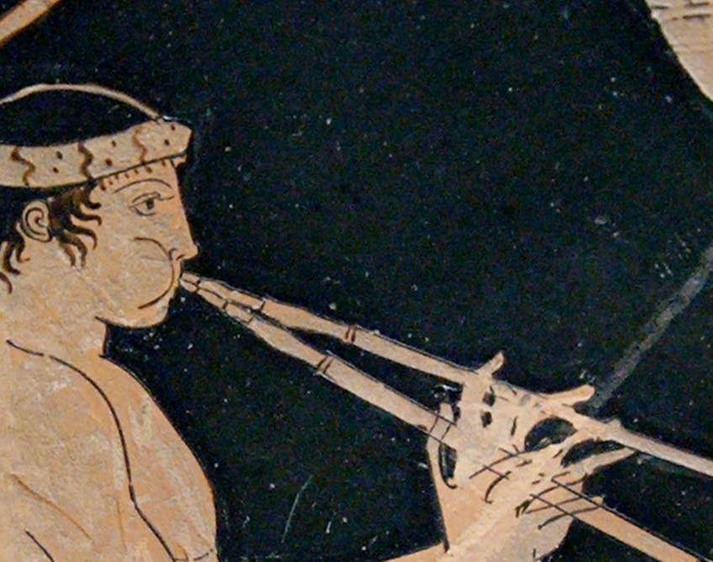
Out of Tune?
Open Access and the Humanities
Notes:
Being the last presenter of the day is not an easy task. But I am not unhappy about it as it is symbolic for the situation of the humanities when it comes to policy making.
The humanities are often an afterthought, an afterthought when we discuss open “science”, open data plans or new forms of research evaluation to name just a few random topics.
With Plan S the situation was not much different. The initial principles, and even the last version of the Plan S guidelines, were developed from the perspective of the sciences – where there is more funding available; where we have a large number of successfully run full OA journals; and where we see a relatively small number of big publishers dominate the arena.
So are the humanities and open access out of tune?

Slide 2
The Funder Takes it all
Gimme! Gimme! Gimme! (A Plan after Midnight)
Waterloo
Notes:
In my presentation I will neither tell you that funders are wrecking our lives, nor will I argue for a fundamentally different OA plan for the humanities.
There is no need for the humanities to surrender. On the contrary, I want to show how the humanities – with the help of librarians and funders - can fully participate in the a transition to a more open future.

Slide 3
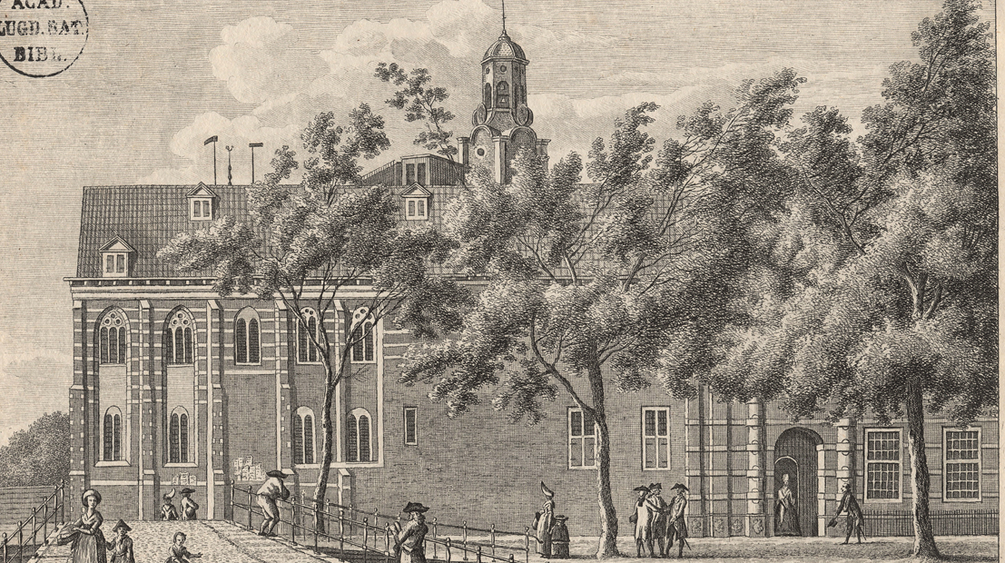
Notes:
I am speaking of the perspective of a commercial, medium-size publisher which has been in business since 1683. Some colleagues of mine are joking that we still publish in the same fields that were hip and trendy some 300 years ago - history, philosophy, religion, classics, middle eastern studies, law – but our portfolio is of course much broader than that. We publish 1,200 new books every year and more than 330 journals.

Slide 4
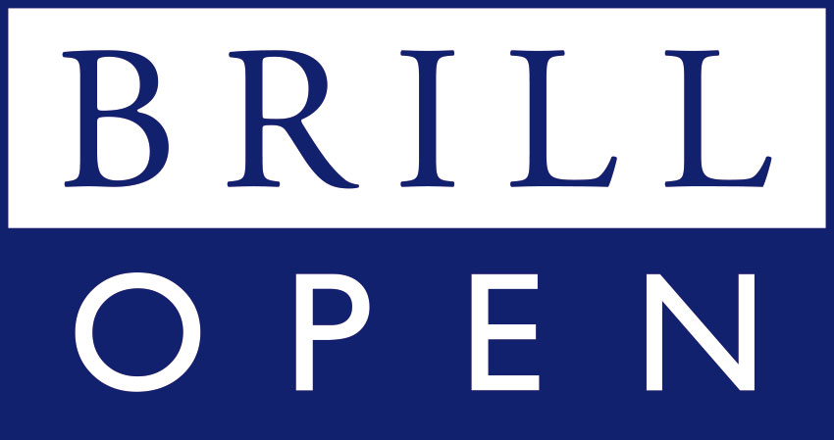


Notes:
When you are in business for such a long time you have to be lucky on the one hand and able to embrace change on the other hand. And Brill has seen quite some change over the last 300 years from being one of the only European publishers able to print Chinese, Arabic and Hebrew characters to offering a fully digital portfolio long before other humanities presses did. We launched our OA program in 2009 – six years after the Berlin Declaration – when many colleagues thought OA would not be possible in the fields we publish in.

Slide 5
25 full OA journals
400+
OA books
8%
of articles OA
4%
of books OA
<2%
of revenue
Notes:
What have we achieved during the last ten years? We publish 25 full OA journals. Most of these journals are diamond OA, so APC free, and funded by one or several institutions. We have flipped subscription journals with Knowledge Unlatched or the help of funders, but admittedly have to flip back at times because funding is not always available long-term. We also publish OA articles in hybrid journals – all our journals are hybrid – but it is less than 1% of our total article output, nice but not really revolutionary.
When you look at the total number of OA articles and compare it to other humanities presses, the 300 year old Brill with all its legacy is not doing bad at all. And in the book space one could even say we are pretty successful with more than 400 OA books published to date.

Slide 6
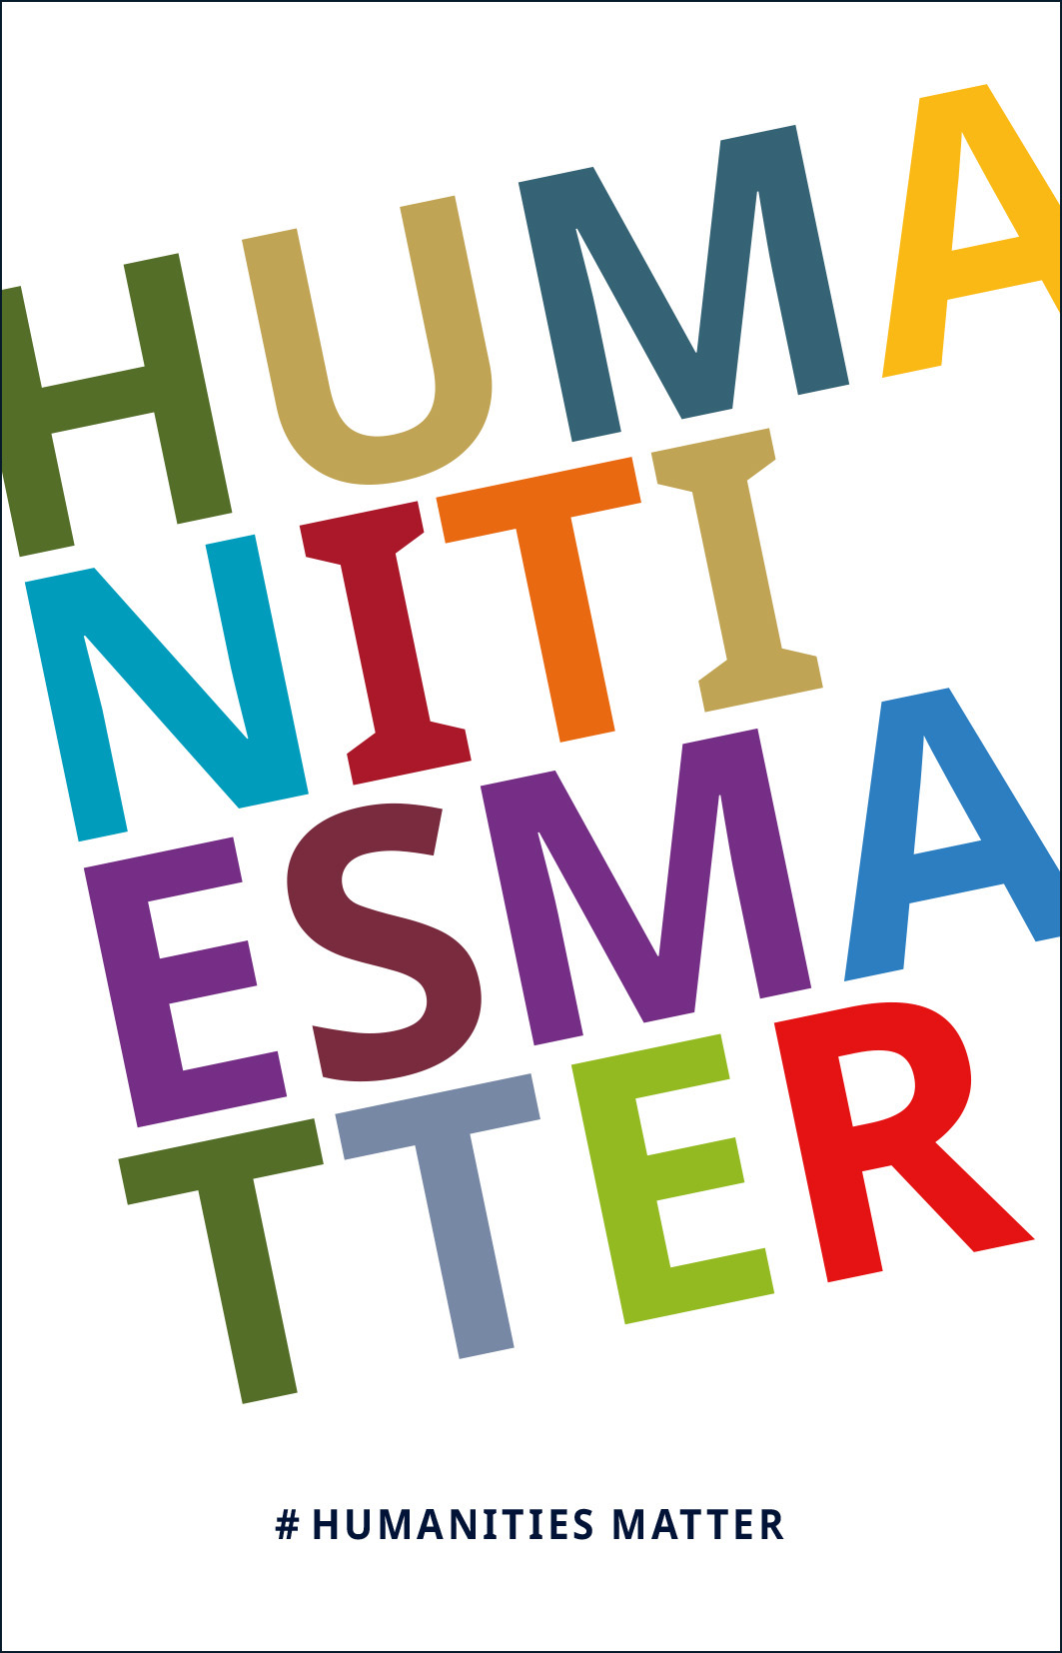
Notes:
However, when we compare this figure – 8% - with the proportion of OA articles in STM – around 20-30% - it is very clear that there is no reason to be complacent. Not just Brill but the humanities in general are far less open than other fields. If funders are not careful with the policies they device and if we publishers are not progressive enough with our strategies, the “openness gap” will get even bigger in the coming years.
As a consequence the humanities would be less visible, show less impact, and ultimately be at a disadvantage when funding decisions are made. This could be a vicious cycle for already vulnerable research fields.

Slide 7
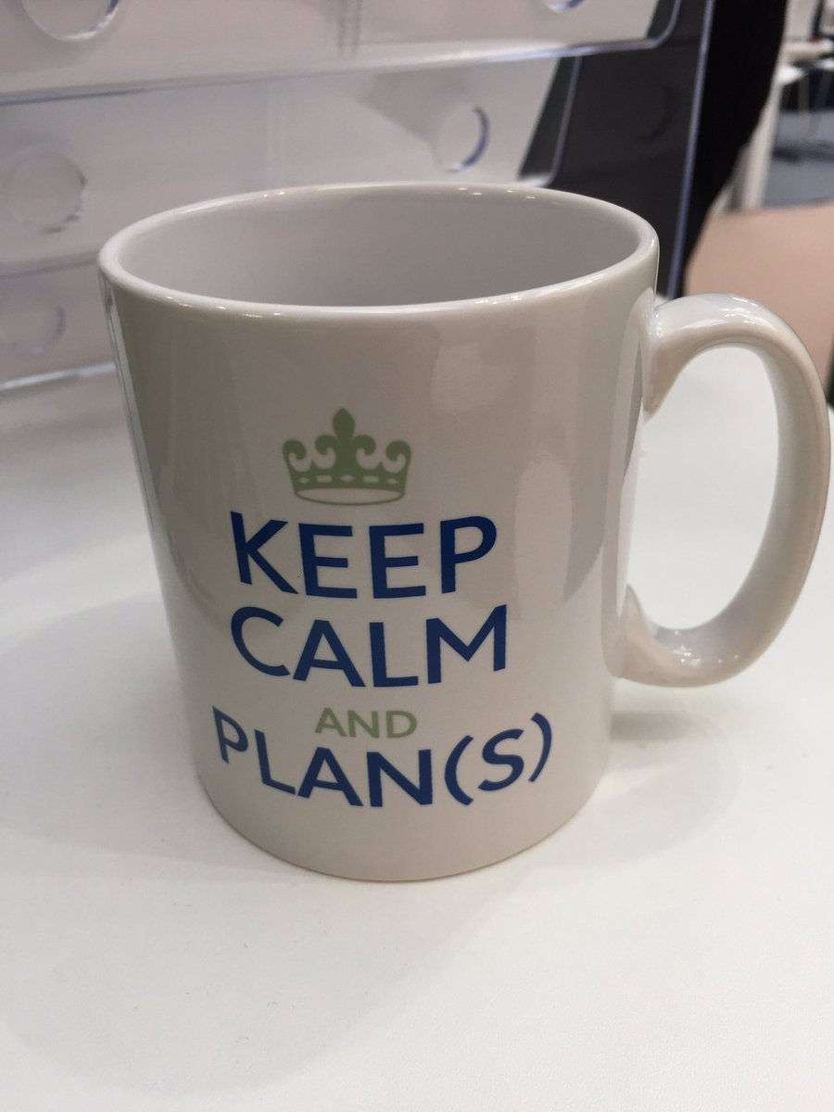
Publicly funded research.
Definitive shift towards
new models of academic publishing.
Accelerate the transition.
Work together.
Efficient, fair, and transparent.
Notes:
cOALitionS has set out to accelerate the transition to open access and to achieve “a definitive shift of publication models”. It is calling for an efficient, fair and transparent transition.
When the open consultation on Plan S took place earlier this year, it was great to see that a lot of HSS scholars, journal editors, and learned societies engaged in the discussion – often for the first time - to shed light on the differences in HSS publishing practices. Brill took part in the consultation, too. Together with 40 other HSS publishers we submitted an open letter to cOAlitionS. The consensus in the HSS community can be summarized in a few sentences: there is no money to pay for gold APCs, journal communities are relatively small, full OA venues are scarce, and HSS publishing has a much longer tail than STM.
This critique of Plans S is usually countered with the argument that HSS scholars can easily be compliant by going for the green route or by using alternative, non-APC models - like diamond OA or different forms of crowd-funding. And it is true that we will probably need a diversity of models to achieve the goal of full and immediate open access for publicly funded research and beyond.

Slide 8
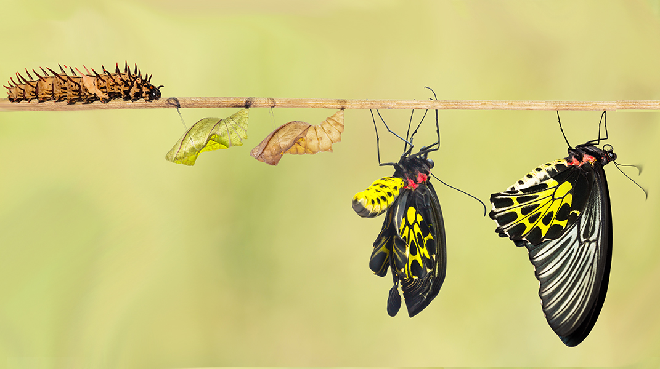
Notes:
If need be, Brill will certainly adjust its embargo periods for Plan S articles so that researchers can publish wherever they want. But is green really a solution that will lead to a “definitive shift of publication models” as cOAlition S is aiming for, or is it not fully relying on the subscription model which we want to change? Is it good enough for the humanities if we “only” archive the AM somewhere in a repository where it is hard to find and doesn’t have the added value of the VoR?
For a real transition in the humanities, I am convinced, we need to move to an entirely new model and use the money that is already in the system. As important as Plan S was as a catalyst for the discussion, the majority of the money is not in the hands of funders – less than 5% of the journal articles we publish derive from cOAlition S grants. The money for an OA transition in the humanities is in the hands of libraries. Only if we manage to shift subscription money to OA on a large scale and with a certain sense of urgency, the humanities will be able to catch up and bring more value to authors, readers and society at large.

Slide 9


Transformative Agreements?
Notes:
Small and medium-size publishers never got access to the Big Deal and some of you might say that is a good thing. But it also means that we are at a huge disadvantage when it comes to negotiating transformative agreements – which would be a fast, efficient and for the humanities suitable way of moving to an OA world. When we look at our total journal revenue (9,8M – including print) and the total number of articles (6,800 – all types of articles) we would get to a reasonable APC and could flip tomorrow.
If it works for us it of course doesn’t mean we can flip individual institutions let alone entire countries easily. What are the obstacles?
(1) Biggest obstacle: We are not invited to the negotiation table, or better said when we want to take a seat we are told “no thank you”. Just recently we had another consortia tell us they can start negotiations with new publishers only in 2021. This is in a country where the national funder has signed up to Plan S – and hence will not meet its own deadline. We, of course, appreciate that there are dozens of publishers that might want to negotiate such agreements and resources on the consortia side are just as limited as on the publishers’ side.
It’s great to see that some consortia have recognized the problem, are switching gears and put more effort – meaning people - into negotiations with a broader range of publishers. What else could help to make negotiations feasible?
- development of model licensing agreements – Wellcome Trust/UKRI funded project to develop a framework for negotiations with society publishers run by Information Power
- start with individual institutions and try to add other institutions to form small, tailor-made consortia outside the official consortia
- smaller publishers could come together in a consortia to negotiate such deals together
(2) Second obstacle: Consortia are asking us to make two steps at the same time. As we often have no Big Deal in place, we have to move from institutional subscriptions, often with a significant proportion of print, to a transformative agreement in one go. Bigger publishers have all been able to make the in-between step of closing a Big Deal which gives access to the entire package. The libraries’ mantra “we do not want to spend more” –might be feasible if you had a Big Deal; it is often not feasible if you have a few institutional subscriptions and have to give full read access to the entire package and on top of that the OA fees.
To illustrate: The APC value of an institution or consortium is often double or triple the amount of subscription value. So we are fundamentally undersubscribed. We understand that it is often not possible to double or triple the spending with us from one year to the next. Instead of ending such negotiations right away – as it seems to be impossible to overcome the gap – we propose to develop a perspective and make 2-4 year plans to get to a fair read and publish deal.
(3) Last obstacle: Even if we could flip easily, meaning the subscription value equals the APC value, we see another obstacle of consortia offering an opt-in instead of an all-in. There are differences how consortia see themselves and Plan S might be a good opportunity to review their role. There are those that mainly serve the needs of individual members, and those that want to be a vehicle to move to a more open world. The Dutch consortium clearly sees itself as the latter and as you all know it works. The Netherlands is very progressed with their OA strategy.

Slide 10

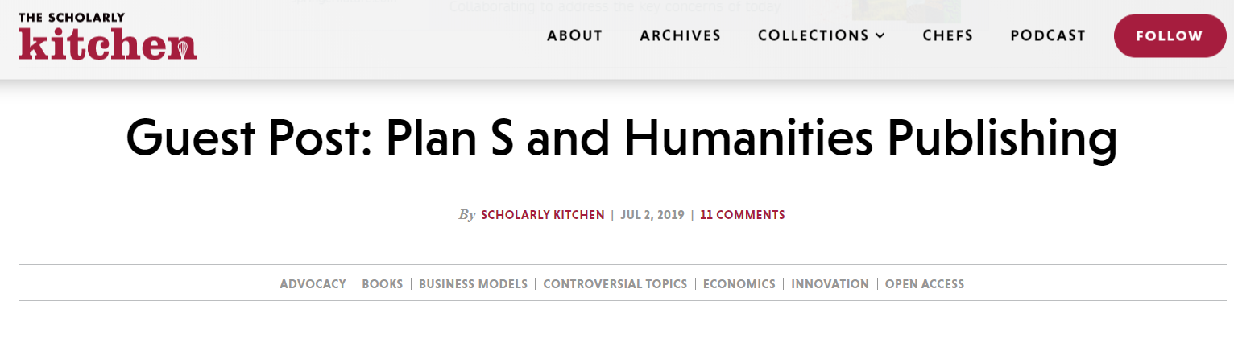
Notes:
In recent years we have seen a number of recommendations and frameworks for libraries and consortia to negotiate transformative agreements with publishers (LIBER, California, etc.). These recommendations are usually based on the experience of negotiations with big publishers – sometimes only on the negotiations with one or two publishers. It might be worth thinking about a set of recommendations for negotiations with smaller publishers.
The basis for such agreements is trust between the partners. Brill and many other publishers are recognising that we need to enlighten the black box of publishing and be more transparency about our services and our pricing. Along with SpringerNature and Hindwai, Brill is on the steering committee of the Welcome Trust/UKRI funded project on transparency in pricing. We are making good progress and have open and constructive conversations with representative of libraries, consortia and funding bodies. The aim is to develop a framework that informs those who pay what they actually get from us in return.
In a recent blog on the Scholarly Kitchen I have stressed the need for researchers, funders, libraries and publishers to work together to accelerate the transition to open access. The humanities must not fall behind but should take a leading position when it comes to efficiency, fairness and transparency. Transformative agreements are a great vehicle to grant access to research on a large scale. They would allow any researcher in any field to publish the outcome of their research in the form and in the venue they prefer.

Slide 11
Jasmin Lange, PhD
Chief Publishing Officer
langej@brill.com
@jasminlange

